Slide 1
Wholesale Database
5
by Nayeem Rahman
GROUP

Slide 2
Database OVERVIEW
01
We have designed a database to accommodate a wholesaler to manage their business. It will allow them to
maintain details about their stock, suppliers, customers, and inventory. It also allows the management to see their profits and fulfillment dates if they do not have adequate inventory to satisfy the customer orders.

Slide 3
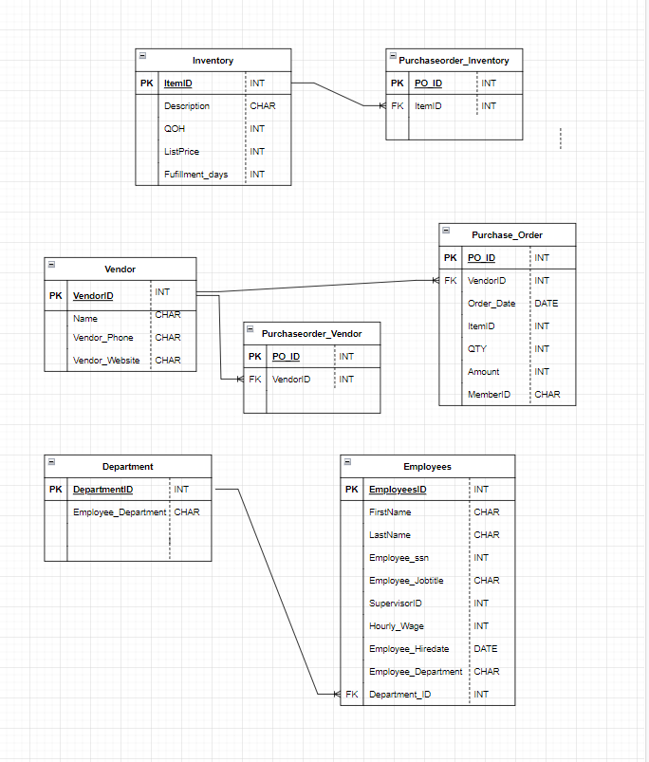
Logical Design

Slide 4
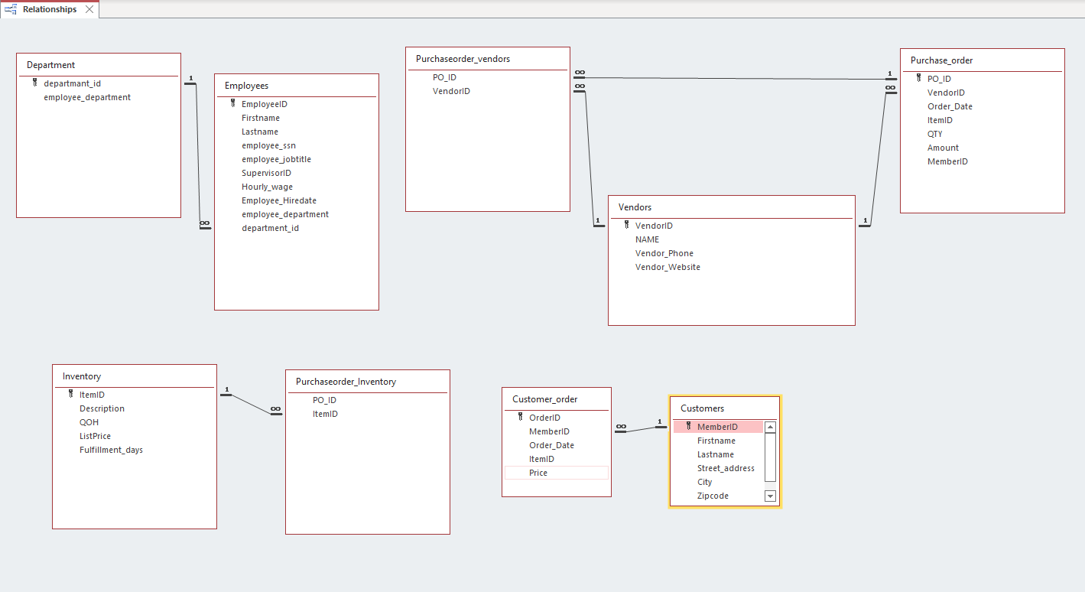
Physical Design

Slide 5

Which of Our Customers Have Spent the Most Money?
SQL VIEW
Data View

Slide 6

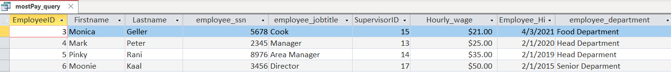
Which employee make over $20 an hour?
SQL VIEW
Data View

Slide 7


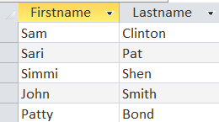
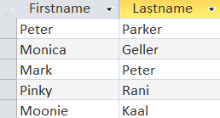
Finding All Employees & Customers
Employees
Customer

Slide 8
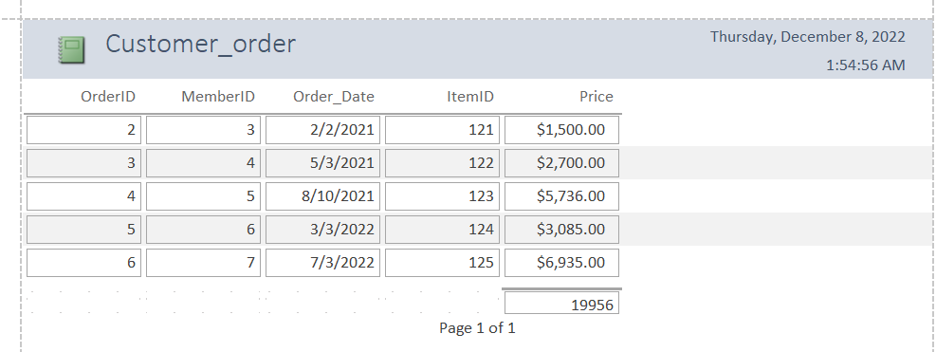
Reports
We’ve created reports that will be useful to managers of the wholesale company, including a report for Customer Orders, Inventory and Vendor

Slide 9
THANKS!
5
GROUP

